Slide 1

CSS Class vs ID Selectors
Which one should I use?
Vincent Baxter

Slide 2
Specificity
Elements
Example: p { color: #000; }
Classes
Example: .description-paragraph { color: #000; }
IDs
Example: #introduction { color: #000; }

Slide 3
Less is more
When possible, general selectors are preferable
Use IDs instead of classes for unique elements
Use classes for repetitive elements

Slide 4



Slide 5

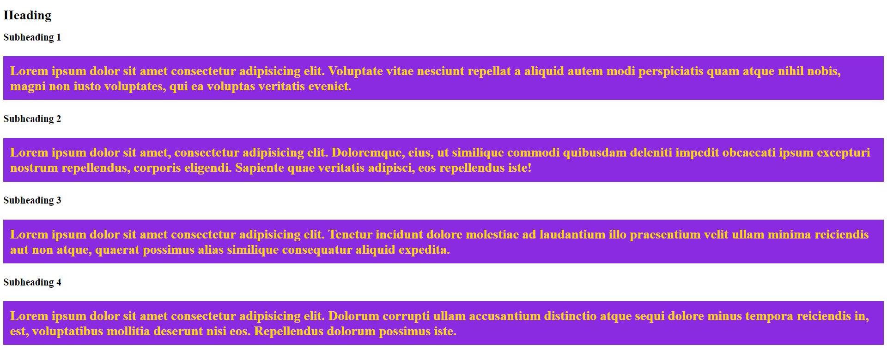

Slide 6


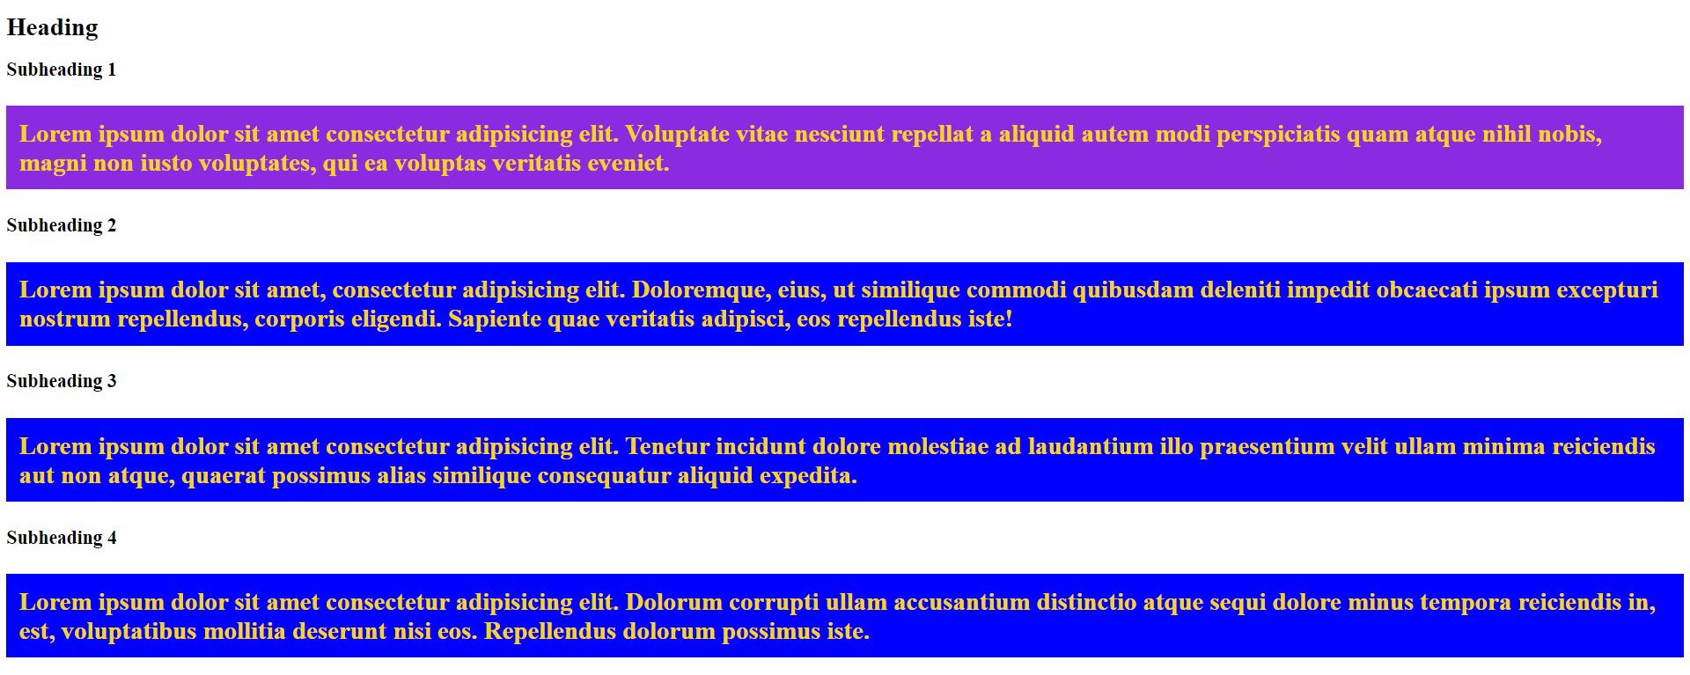

Slide 7


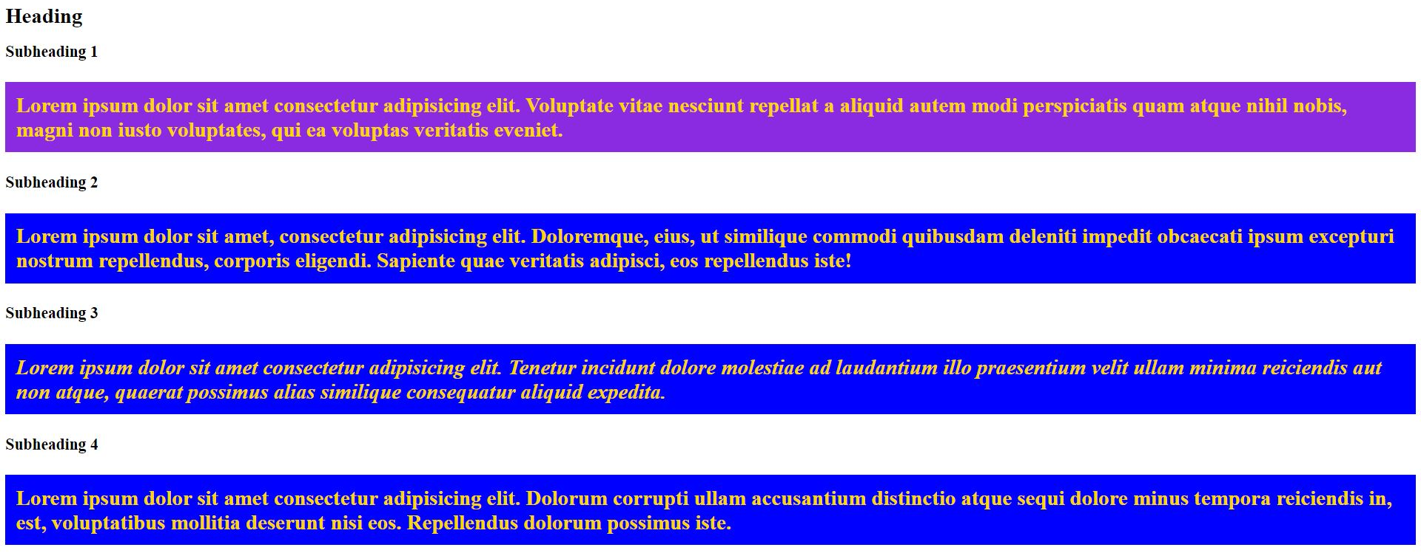

Slide 8

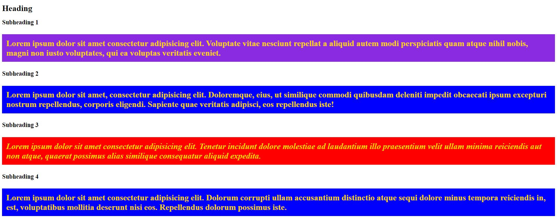

Slide 9
Descendant selectors
Example 1
.description .nature p { font-style: italic; }
Example 2
.description .city p { text-decoration: underline; }

Slide 10
Descendant selectors
Example 1
.myhouse .contents .dog { position: sit; }
Example 2
#rover { position: sit; }

